Slide 1
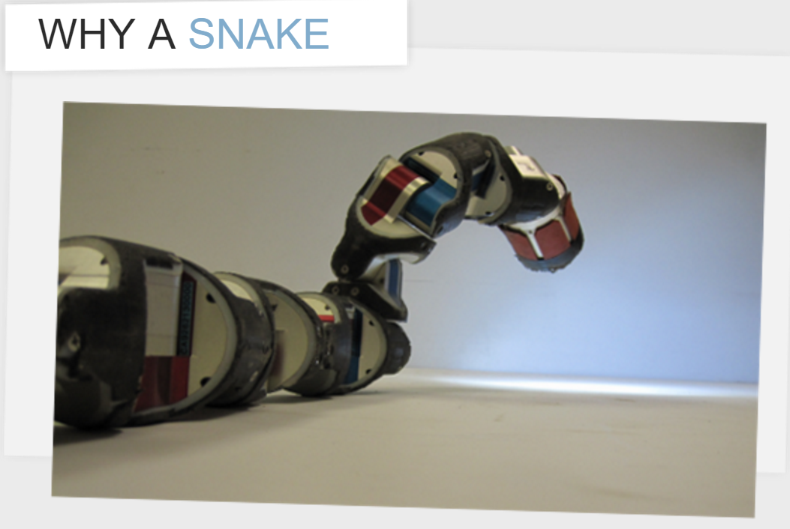
Robotics-CMU robot snake
410286026 通訊四 呂冠勳
Department of Communication Engineering

Slide 2
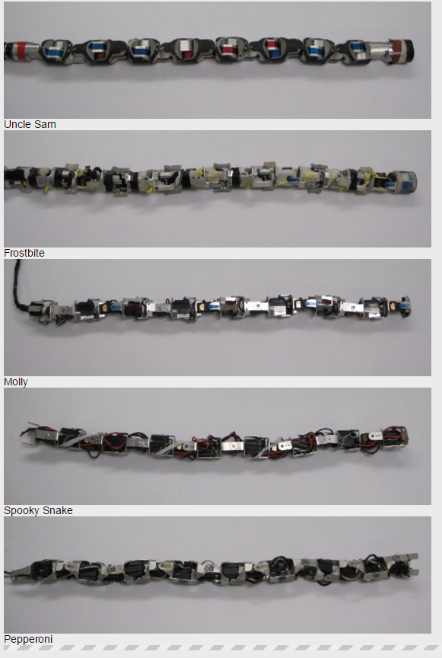
What is snake robot?
A snakebot, also known as snake robot, is a biomorphic hyper-redundant robot that resembles a biological snake. Snake robots come in many shapes and sizes, from the four stories long, earth quake snakebot developed by SINTEF,[1] to a medical snakebot developed at Carnegie Mellon University that is thin enough to maneuver around organs inside a human chest cavity. Though snakebots can vary greatly in size and design, there are two qualities that all snakebots share.

Slide 3
Features
First, their small cross section to length ratio allows them to move into, and maneuver through, tight spaces.
Second, their ability to change the shape of their body allows them to perform a wide range of behaviours, such as climbing stairs or tree trunks.
Additionally, many snake robots are constructed by chaining together a number of independent links. This redundancy makes them resistant to failure, because they can continue to operate even if parts of their body are destroyed.

Slide 4
Applications
Snakebots are most useful in situations where their unique characteristics give them an advantage over their environment. These environments tend to be long and thin like pipes or highly cluttered like rubble. Thus snakebots are currently being developed to assist search and rescue teams.
For example, if you need a robot to carry a camera to the top of a tree that is growing in water you have to do three things: move over ground to the water's edge, swim to the tree, and then climb the tree.

Slide 5
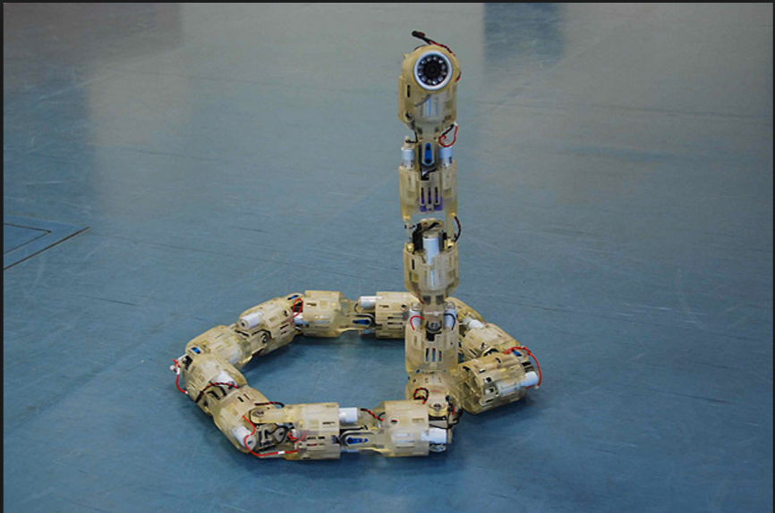
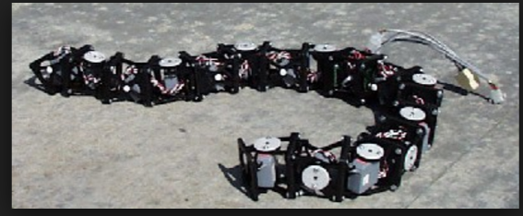
Pictures

Slide 6
Video – Four Different Types gaits
Indoor-https://www.youtube.com/watch?v=Lwj-hBejlkQ
Terrain-https://www.youtube.com/watch?v=NPV4HhvvvJg
Pipe-https://www.youtube.com/watch?v=lqUo-vaHdAQ
Climb-https://www.youtube.com/watch?v=Nas2OsHY92M

